Slide 1
Data Descriptor: Open University Learning Analytics dataset
Jakub Kuzilek
Martin Hlosta
Zdenek Zdrahal
Knowledge Media Institute, The Open University, UK
Czech Technical University, Czech Republic

Slide 2

The Open University
One of the largest distance learning universities worldwide
Around 170,000 students
Open University Learning Analytics dataset (OULAD):
Contains a subset of the Open University student data from 2013 and 2014
https://www.classcentral.com/university/tou

Slide 3
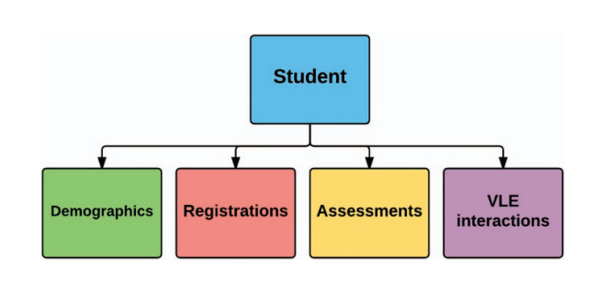
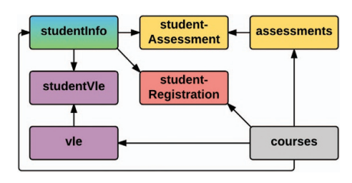
Open University Learning Analytics dataset (OULAD)
Overall dataset structure
Detailed dataset structure

Slide 4
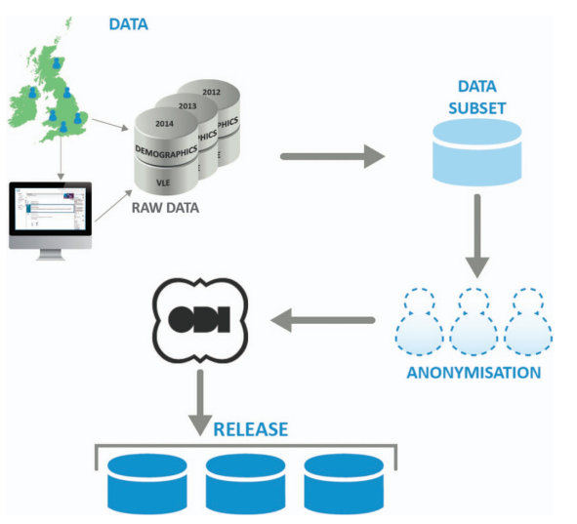
Dataset preparation process

Slide 5
Data selection
● The number of students in the selected module is larger than 500.
● VLE data are available for the module (since not all the modules are studied via VLE).
● The module has a significant number of failing students.
→7 modules: 4 Science, Technology, Engineering, and Mathematics (STEM) modules and 3 Social Sciences modules.
The total number of students in the selected modules is 38,239.

Slide 6
Data anonymization
During the admission process, students are informed:
Data Protection Policy
Policy on Ethical use of Student Data for Learning Analytics
The first step removed private information: social security number, dates of birth and unique identifiers
Module names have been replaced by semantic-free symbols
ARX anonymization tool for attributes like gender, highest education level, age, region and disability was applied

Slide 7
Technical Validation
They compared the OULAD data with the corresponding data from 2015.
They employed Chi-squared test of goodwill or Wilcoxon rank sum test, depending the type of attributes
Outcomes:
slight differences between OULAD CCC module and corresponding data from the year 2015 (caused by a different number of students registered for module each year)
largest difference can be observed in index of multiple deprivation (because it is correlated with the postcode of student home, which changes rapidly)
P-value ranges from 0.15 to 0.93 → no statistically significant difference between distributions of OULAD and testing data → dataset is still actual and reflect the current student population well

Slide 8
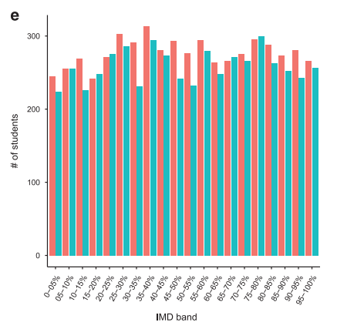
Technical Validation

Slide 9
Epistemology
A1) What Are We Measuring?
We are measuring student interaction behaviors, performance and satisfaction in the Virtual Learning Environment (VLE) at The Open University.
A2) How Are We Measuring?
We are measuring behaviors via Learning Management Systems (LMS) along with ed tech tool analytics, performance via student scores and satisfaction via surveys.

Slide 10
Pedagogy
B1) Why is this Knowledge Important to Us?
Measuring students' interaction behaviors, performance and satisfaction with their university courses, the university and the professors are able to efficiently evaluate their teaching methods and the overall program. Thus, they are able to optimize different procedures that best fit the students and benefit them the greatest.
B2) Who is the Analytic For?
The analytic is for the university’s students as well as for the teacher because the decisions making after the analysis will benefit both.

Slide 11
Assessment
C1) Where Does the Data Collection Happen? (Context)
The data collection is happening online for the aim of The Open University (OU) via the VLE.
C2) When Does the Data Collection & Feedback, Occur? (Temporal Context)
The Open University Learning Analytics dataset (OULAD) contains a subset of the OU student data from 2013 and 2014. The analysis was made by Jakub Kuzilek, Martin Hlosta and Zdenek Zdrahal (Knowledge Media Institute -The Open University and Czech Technical University).

Slide 12
Human-Centered Learning Analytics (HC-LA) approach
NO human-centered learning analytics approach
simple educational and demographic data
no active contribution of the students
no collaboration between university - students - researchers
simple chi-squared tests comparing old with new data

Slide 13
Our approach
Descriptive analytics
Hypothesis Testing
Linear Regression
Polynomial Regression
Classification

Slide 14
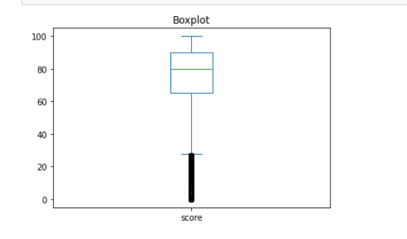
Descriptive Analytics
Boxplot of scores:
Min
Max
Median
Outliers

Slide 15
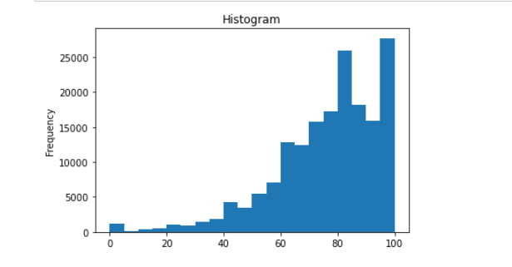
Descriptive Analytics

Slide 16
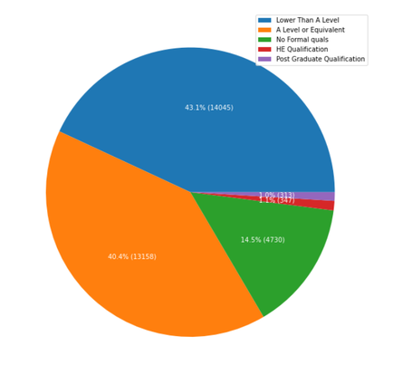
Descriptive Analytics
Pie: Education of students

Slide 17
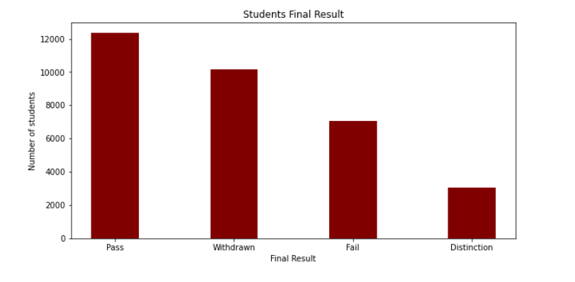
Descriptive Analytics
Bar chart: students’ final result

Slide 18
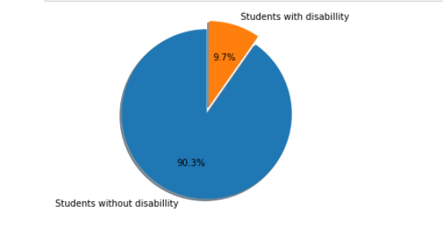
Descriptive Analytics

Slide 19
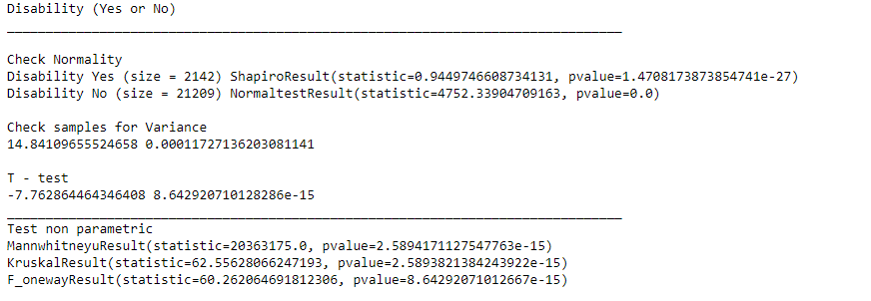
Hypothesis Testing (1)
Does disability affect the mean assessment score?

Slide 20
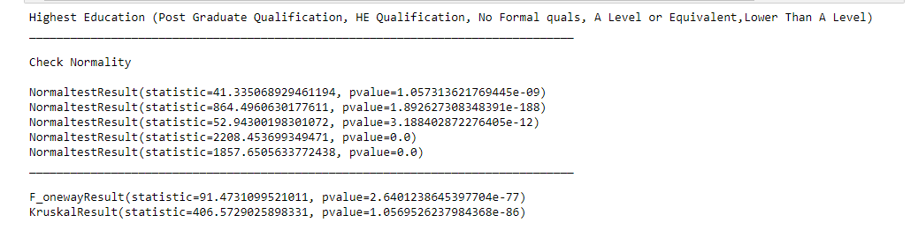
Hypothesis Testing (2)
Does previous education affect the mean assessment score?

Slide 21
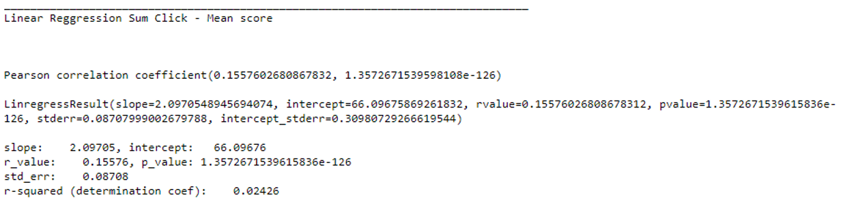
Linear Regression (1)
Does the sum clicks affect the mean score?
Does sum clicks affect the mean assessment score?

Slide 22
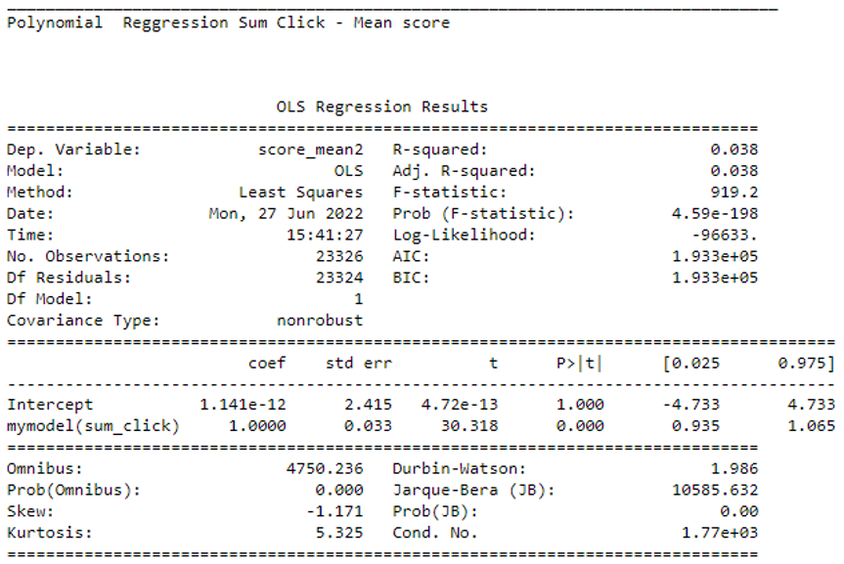
Polynomial Regression (2)
Does the sum clicks affect the mean score?

Slide 23
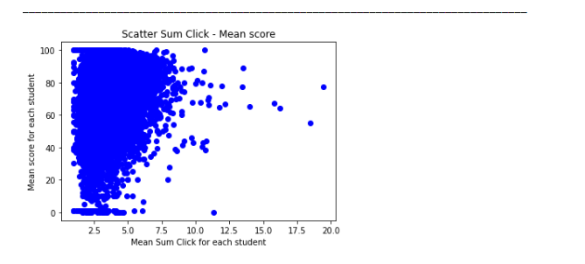
Scatter plot

Slide 24
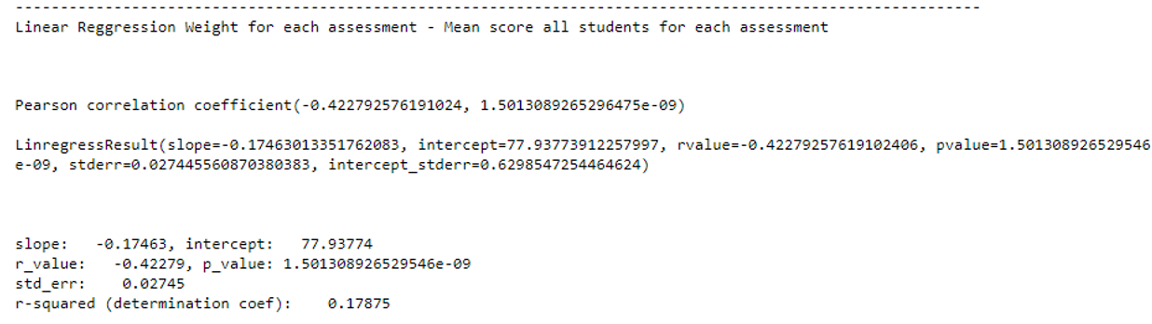
Linear Regression (2)
Does the weight of each assessment affect the mean each assessment score of all students?

Slide 25
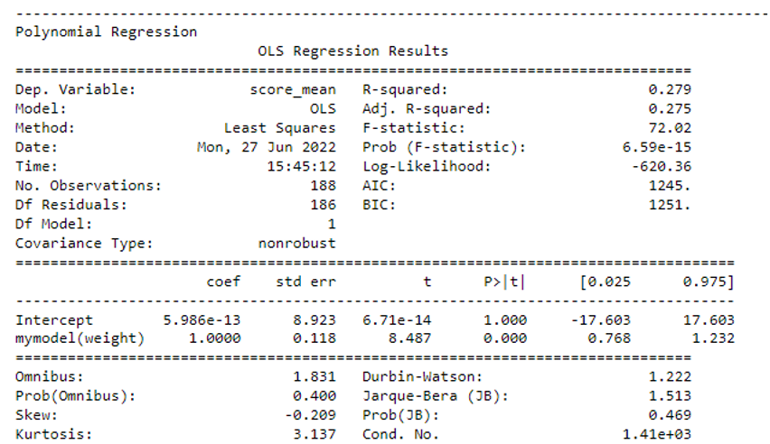
Polynomial Regression (2)
Does the weight of each assessment affect the mean each assessment score of all students?

Slide 26
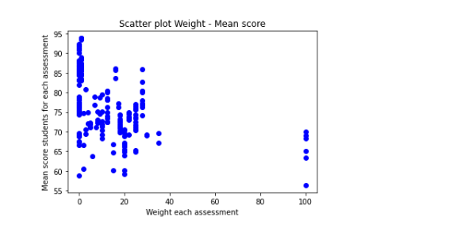
Scatter plot

Slide 27

Classification
Input: region, age
Output: Final result (pass, fail, distinction, withdrawn)

Slide 28
Thank you for your attention!
Questions?
Γκόγκος Χρίστος
Παπαδοπούλου Δανάη
Σουλιώτης Νικόλαος

